Slide 1
Database Design Chat 001
Hello, and the one major thing every database must get right!

Slide 2
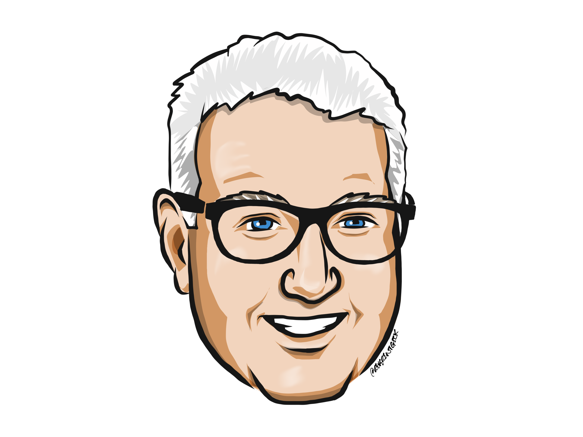
About Me
Been a Microsoft MVP for 17 years.
In other words, I don’t sleep enough
Written 6 books on Database Design
See previous sub bullet
Been a data architect and coder for over 20 years
Not only am I aging faster than others because of lack of sleep, I also am old
I have other hobbies, but they don’t pay as well
https://linktr.ee/drsql

Slide 3
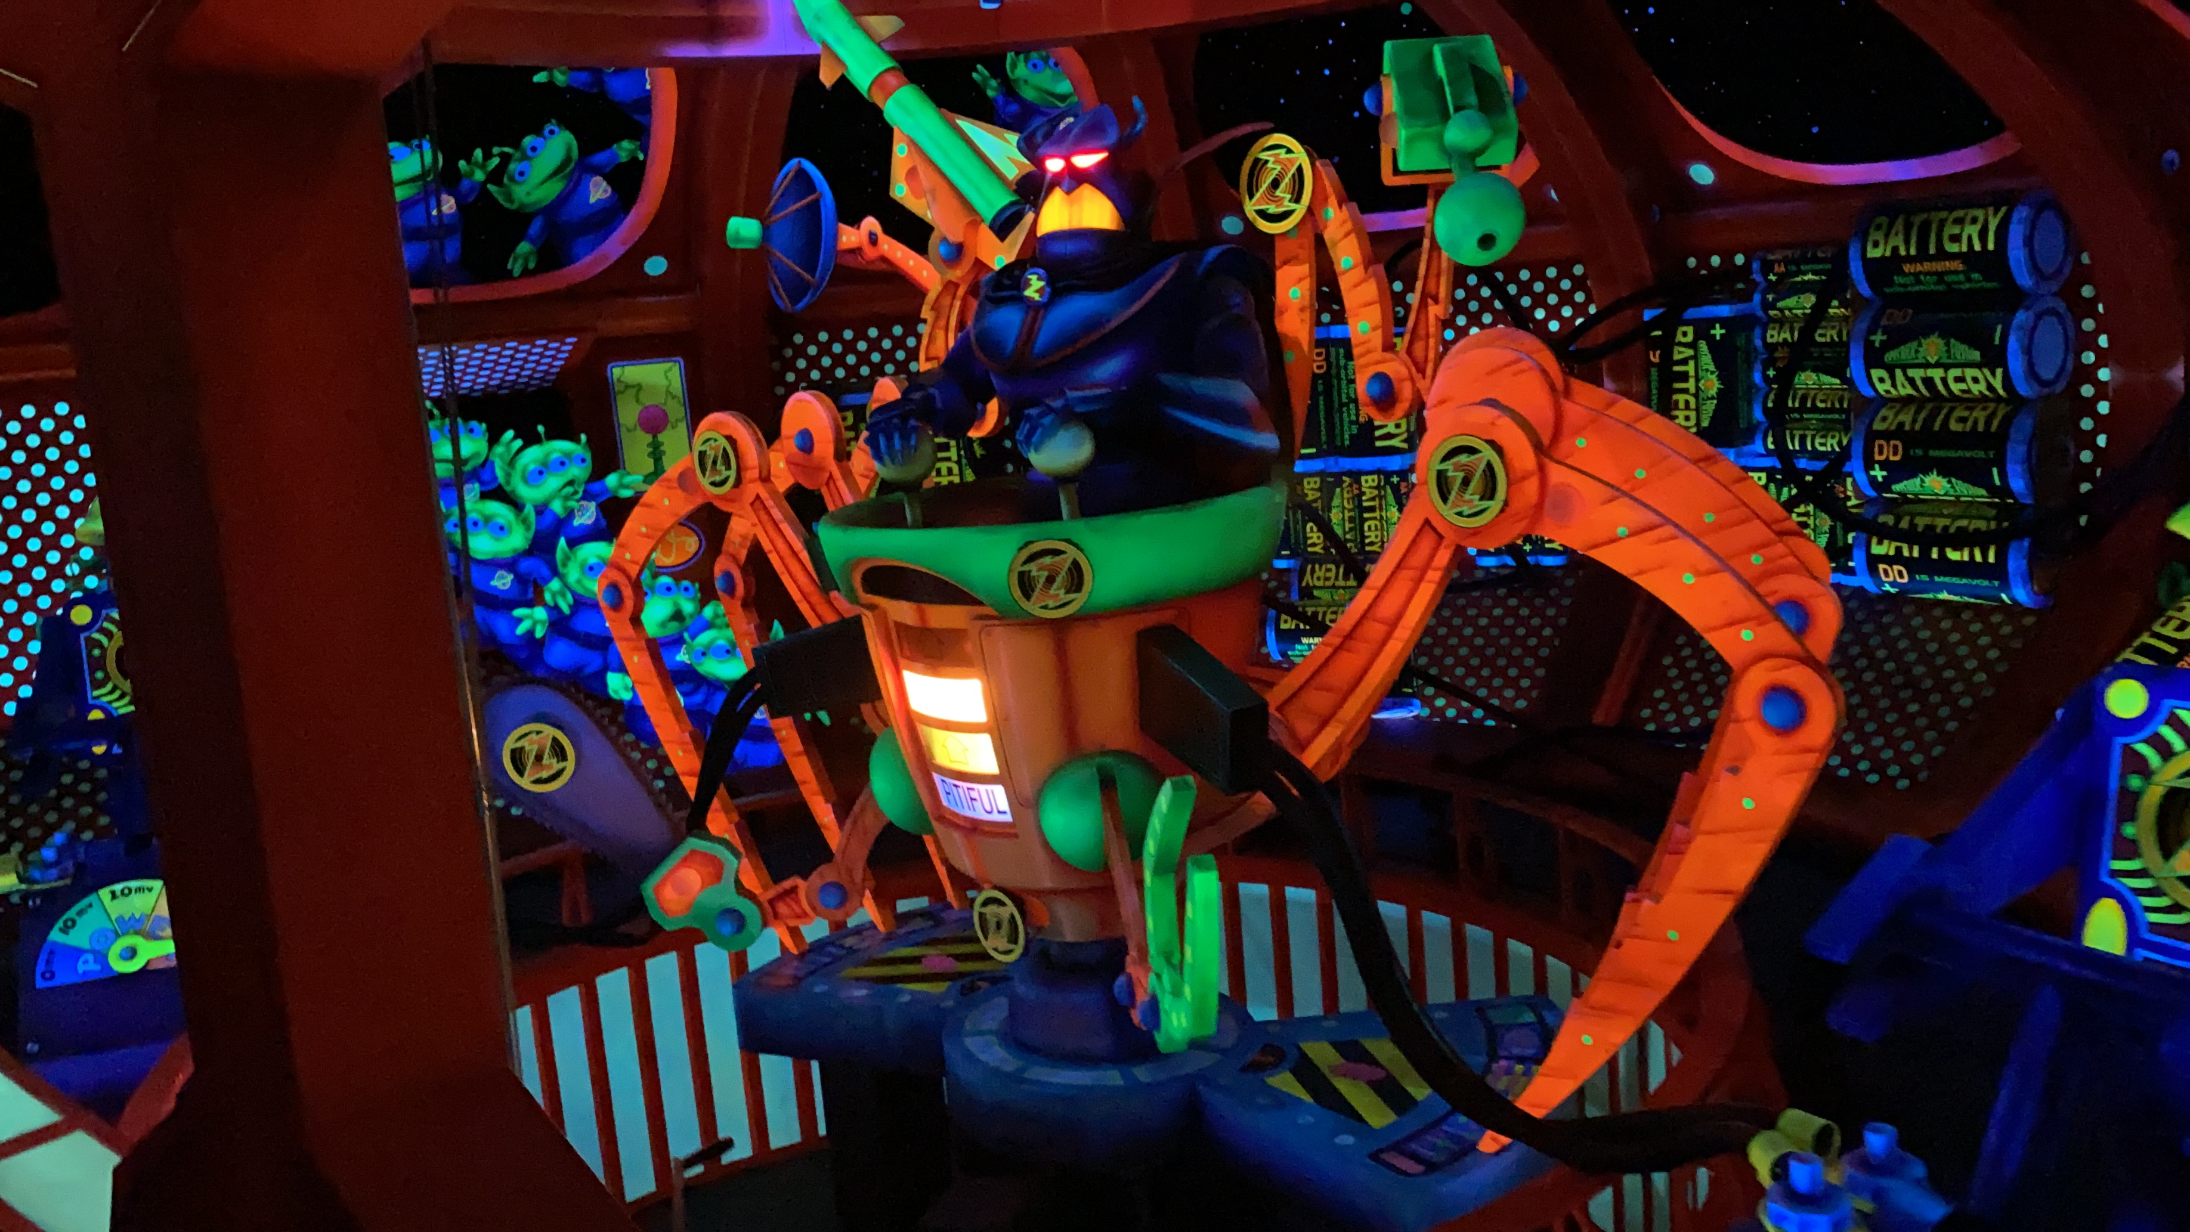












Theme Park Pictures, Blogs, and Vlogs
https://linktr.ee/FigmentsAllOverThePlace

Slide 4
The Most Important Thing
…Isn’t
Structure
Performance
Quality
Technical impressiveness
Looks pretty
Replaces manual processes
Normalization
That is uses a certain product
Ease of use
Security
All crucial, but not the most crucial

Slide 5
The Most Important Thing
…Is
Correctness

Slide 6


Correctness
Wikipedia defines correctness in Computer Science as:
In theoretical computer science, an algorithm is correct with respect to a specification if it behaves as specified. Best explored is functional correctness, which refers to the input-output behavior of the algorithm (i.e., for each input it produces an output satisfying the specification).^{[1]}
https://en.wikipedia.org/wiki/Correctness_(computer_science)

Slide 7
Reality check…
Software has bugs
Perfectly correct software is generally only possible for simple cases
Write software to:
Add two specific numbers together: easy to write and test
Add any two numbers together: not super complicated, but can’t test EVERY case
We have to trust algorithms to work
The pros and cons of “good enough” is later topic!

Slide 8
Until next time…
Correctness is the most important goal!
The best-looking software, using the latest tools, that is designed by the best programmer on earth that…
Doesn’t do what the customer wanted…
Is the worst piece of software created…
Understand the problem first, then solve it!

